Slide 1
“E-Commerce”
SRS for E-commerce

Slide 2
Amkart
E-com is buying and selling of goods & services , over an electronic network, primarily the internet .
LMS Username | Name | Batch
2115a27 | THIRUMALAI V | A2
2115a25 | SIVANANDAM M | A2
2115a240 | SATHISH S | A2

Slide 3

E-commerce(Amkart)
Outline
What is E-commerce ?
E-commerce Model
Impact of E-commerce
Advantages
E-commerce challenges
E-commerce Acquisition Timeline
References

Slide 4
1) What is E-commerce ?
E-commerce (electronic commerce) is the activity of electronically buying or selling of products on online services or over the Internet. E-commerce draws on technologies such as mobile commerce, electronic funds transfer, supply chain management, Internet marketing, online transaction processing, electronic data interchange (EDI), inventory management systems, and automated data collection systems. E-commerce is in turn driven by the technological advances of the semiconductor industry, and is the largest sector of the electronics industry.
Order it…
Get it…

Slide 5

2) Types of E-commerce :
Business-to-Consumer (B2C)
Consumer-to-Business (C2B)
Business-to-Business (B2B)
Consumer-to-Consumer (C2C)
Business-to-Administration (B2A)
Consumer-to-Administration

Slide 6
3) Impact of E-commerce :
Cookie Central, http://www.cookiecentral.com.
Bake Your Own Internet Cookie, Privacy.net, http://www.privacy.net/cookies/
Electronic Frontier Foundation, The Web Bug FAQ, http://www.eff.org/pub/Privacy/Profiling_cookies_webbugs/web_bug.html.
18 U.S.C. §§ 2510-22, http://caselaw.lp.findlaw.com/casecode/uscodes/18/parts/i/chapters/119/toc.html.
18 U.S.C. §§ 2701-11, http://caselaw.lp.findlaw.com/casecode/uscodes/18/parts/i/chapters/121/toc.html.
Bohach v. City of Reno, 932 F. Supp. 1232, 1236 (D. Nev. 1996).

Slide 7

4) Advantages :
1. Lower prices
2. Convenient and safe
3. Wide product variety
4. More informed decision-making
5. Saves time
6. Wider customer base
7. Easier to scale up
8. Open always
9. Flexibility and speed

Slide 8

5) E-commerce challenges :
When it comes to eCommerce, one of the biggest challenges faced is security breaches. There is a lot of information/data that is involved while dealing with eCommerce and a technical issue with data can cause severe damage to the retailer’s daily operations as well as brand image.

Slide 9
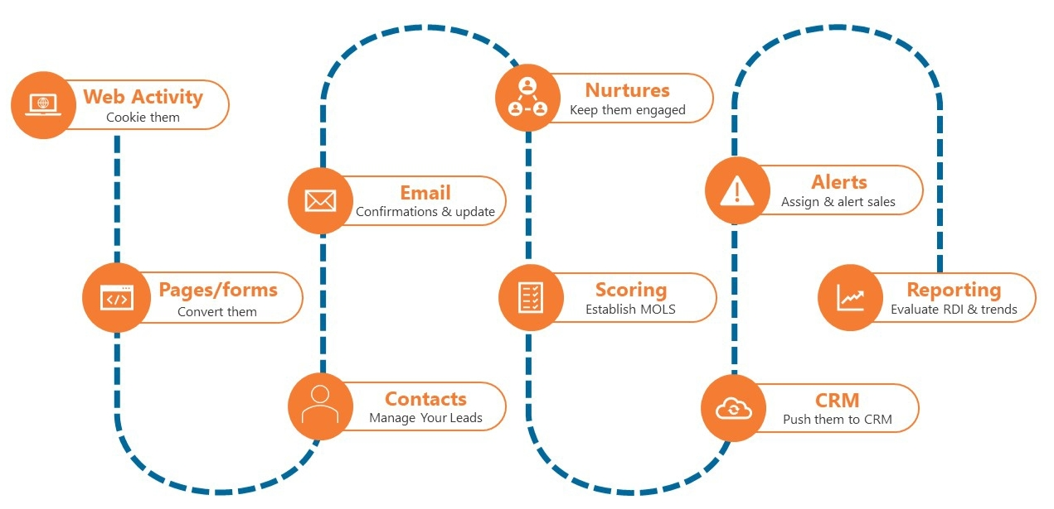
6) E-commerce Acquisition Timeline :

Slide 10

7) Future of ecommerce :
Growth and expansion of online marketplaces
Increased use of mobile devices for ecommerce
Continued focus on personalization and customization
Advances in artificial intelligence and automation

Slide 11
7) References :
"Retail e-commerce sales CAGR forecast in selected countries from 2016 to 2021". Statista. October 2016. Archived from the original on 26 November 2017. Retrieved 4 May 2021.
Wienclaw, Ruth A. (2013). "B2B Business Models" (PDF). Research Starters: Business. Archived (PDF) from the original on 18 July 2013. Retrieved 4 May 2021.
Subramani, Mani; Walden, Eric (June 2001). "The Impact of E-Commerce Announcements on the Market Value of Firms". Information Systems Research. 12 (2):135–154. doi:10.1287/isre.12.2.135.9698. ISSN 1047-7047.

Slide 12
Submission Github
https://github.com/Thiruv

Slide 13


